Slide 1

ATHFINDER
ENDLESS POSSIBILITIES

Slide 2
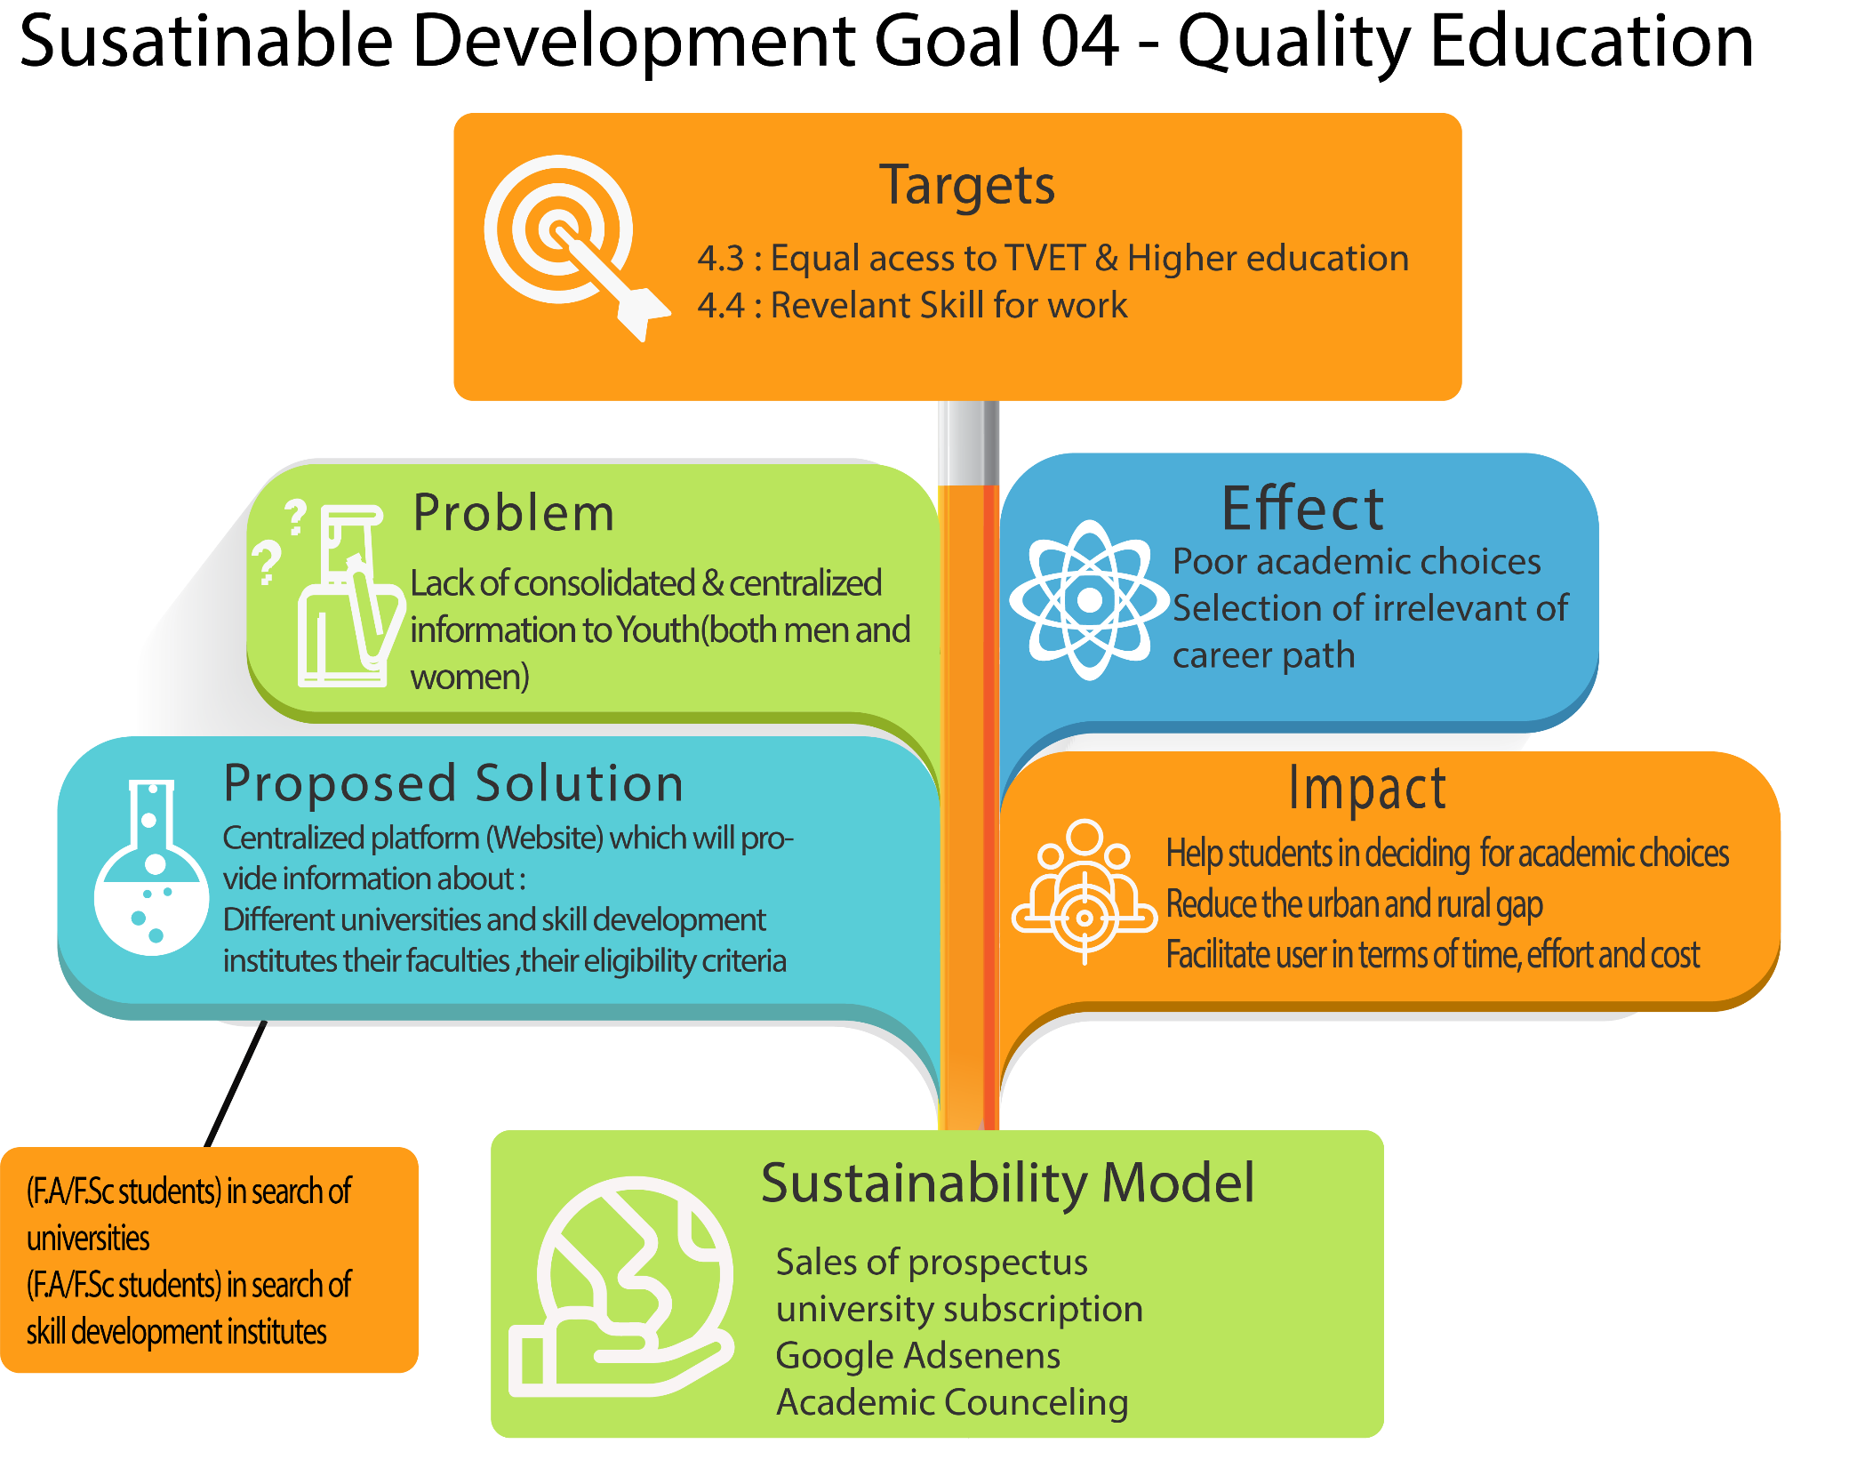

Slide 3
Problem Identified:
Lack of consolidated & centralized information for Youth(both men and women)
Effects:
Poor academic choices
Selection of irrelevant of career path
Notes:
May require more than one slide

Slide 4
Sustainable Development Goal 4- Quality Education
Target Selected 1:
Target 4.3. By 2030, ensure equal access for all women and men to affordable and quality technical, vocational and tertiary education, including university.
Target Selected 2:
Target 4.4. By 2030, substantially increase the number of youth and adults who have relevant skills, including technical and vocational skills, for employment, decent jobs and entrepreneurship
Notes:
Field suggestions will be provided after calculation of eligibility criteria calculator. One can enter his/her marks and decide whether to pursue study in field or not?
Students can compare two different field of study according to their eligibility.

Slide 5
Proposed Solution
Centralized platform (Website) which will provide information about :
Different universities, their faculties ,their eligibility criteria and fee structure.
Different skill development institutes, their courses including diplomas, their eligibility criteria and fee structure.

Slide 6
Impact
Help students in deciding for academic choices
Reduce the urban and rural gap
Facilitate user in terms of time, effort and cost

Slide 7
Target Group:
Youth (F.A/F.Sc students) in search of universities
Youth (F.A/F.Sc students) in search of skill development institutes

Slide 8
Thank You

